Slide 1
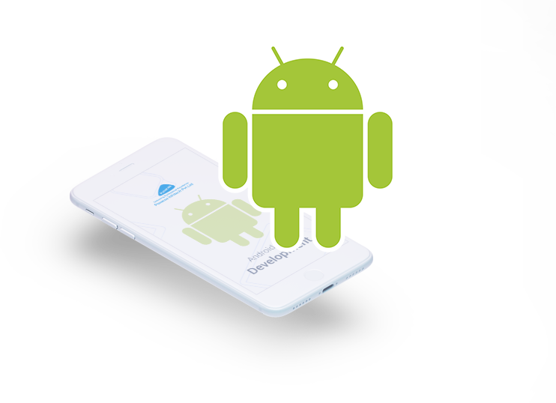
We-connect.
Student Handler Application.
1.Text Books
2.Notification’s

Slide 2
Abstract
Introduction
Present vs proposed system
System Specification
UML
Development procedure
Review
Conclusion

Slide 3
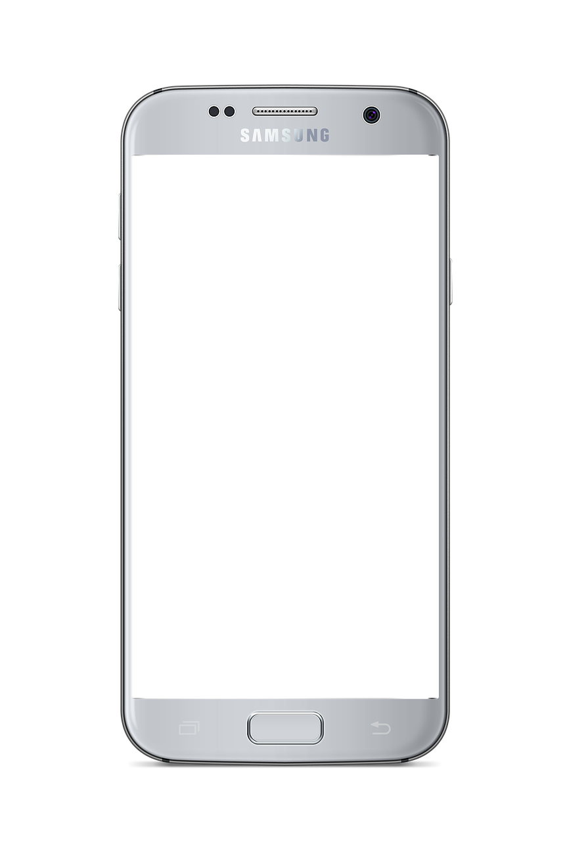







Micro-services Architecture.
Client Application
Https – SSL – JSON.

Slide 4
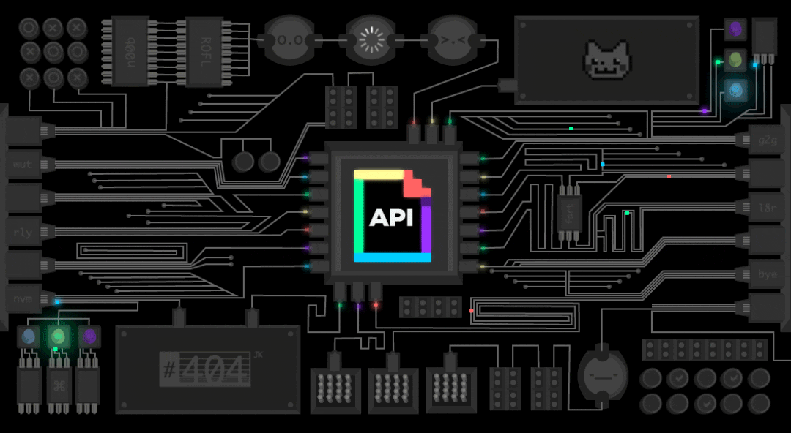

Slide 5
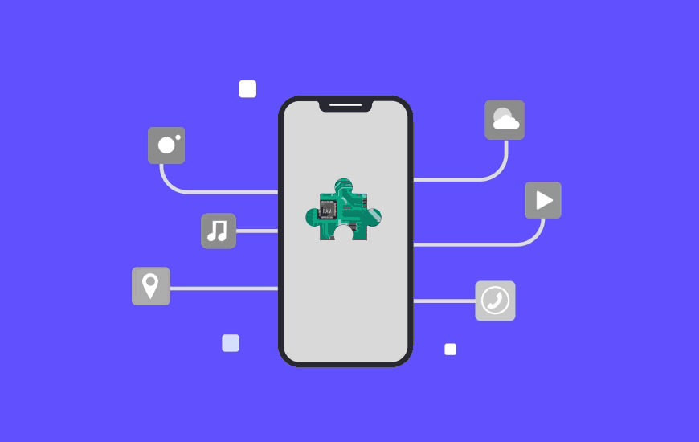

Slide 6
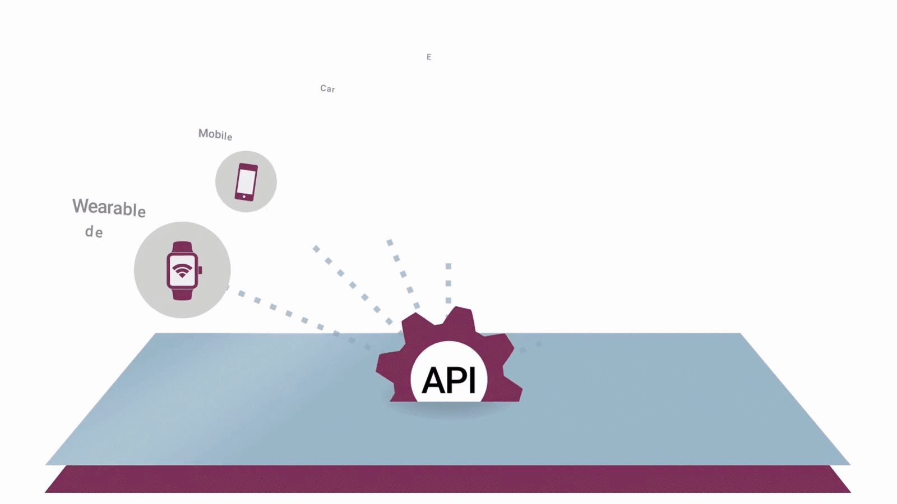

Slide 7
MAPPING ADMINISTRATOR IN REST API SYSTEM JERSEY.

Slide 8
POSTGRES DATABASE
HIBERNATE ORM
REST APP
RESPONSE
REQUEST
MONGO DB
1.GET
2.PUT
3.POST
4.DELETE

Slide 9













Administrator View

Slide 10



